Slide 1
Safety considerations during site selection of a chemical plant
Chemical Plant Safety
Unit - II

Slide 2
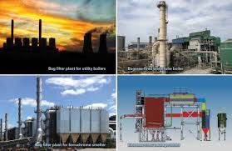
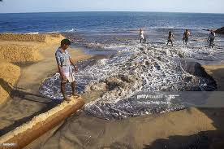
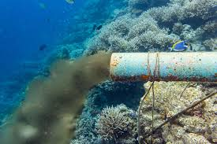
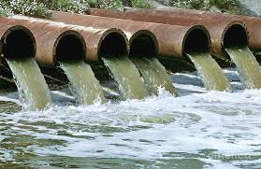
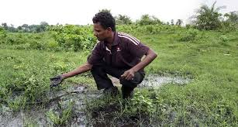
Highlights – India’s present status – effluents-pollution
86.211 tons of technical grade insecticides annually to cover 182.5 million hectares of its cultivated land
In 1,95,000 m³ of sewage – 95% is untreated – directly pumped to sea
630 millions litres of untreated , large amount of partially treated sewage enters the river Yamuna
Rapid industrialization:
Resulted in population migration for business and livelihood purposes
48.8% - vehicles – CO₂ released
470 tpd - Mumbai
810 tpd - Delhi
188 tpd - Kolkata
Tamilnadu – tops of grossly polluting discharge into water
Drinking sources polluted toxic effluents
Tannery
Dyes and chemical industries
Paper and pulp mills
Breweries
fertilizers

Slide 3

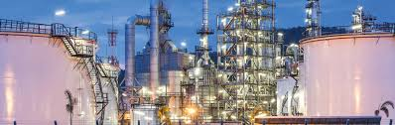
Industry – siting criteria
Preventive steps are needed for time of siting rather than going in for curative measures at later stage
Before setting up the industry should obtain clearance from “Ministry of Environmental and Forests”, to achieve ecological safety
Industries are required to be sited, needs a balance between economic and environmental considerations

Slide 4
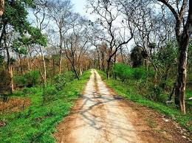
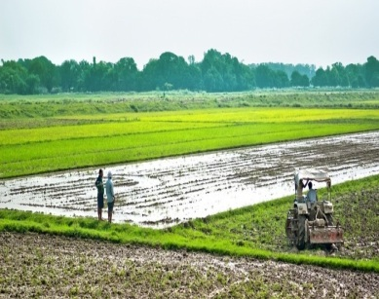
Following factors must be considered for Siting
No forest land shall be converted into non-forest activity for the sustenance of the industry (Forest conservation act – 1980)
No prime agricultural land shall be converted into an industrial site
Land acquired shall be sufficiently large enough to provide space for appropriate treatment of wastewater after maximum possible reuse and recycling
Enough space should be provided for storage of solid wastes so that it will be possible for reuse
Layout and form of industry that may come up in the area must conform to the landscape of the area without affecting the scenic features of that place
Physiographic barrier between the industry and township
Industry required to maintain three ambient air quality measuring stations at 120 deg.C angle between stations

Slide 5
Environmental guidelines
To ensure optimum use of natural and man-made resources in a sustainable manner:
Minimal depletion
Degradation, and/or
Destruction of the environment
The following distances from industrial sites should be taken into account
Ecological /sensitive areas
- atleast 25 km away depending on geo-climatic conditions
2. Coastal Area
- At least ½ km from high tide line
3. Floodplain of the Riverine systems
- At least ½ km from floodplains or modified floodplains, affected by dams in the upstream or by flood control systems
4. Transport/communication system
- At least ½ km from the highway lines and railway station
5. Major settlements (3,00,000 population)
- At the time of siting of industry,if any major settlements are noted within 50 km the spatial direction of growth of settlement must be assessed

Slide 6

Environmental Impact Assessment (EIA) -
Environmental assessment (EA) is the assessment of the environmental consequences (positive/ negative) of a plan, policy, program, or actual projects prior to the decision to move forward with the proposed action.
EIA should address some basic factors:
Meteorology and air quality
Hydrology and water quality
Site and its surroundings
Occupational safety and health
Details of treatment and disposal of effluents
Transportation of raw material and details of material handling
Control equipment and measures proposed to be adopted

Slide 7
Site appraisal committees
State government constitute site appraisal committees for the purpose of advice, reg. granting of permission
The chief inspector of the state (chairman)
A representative from the central pollution control board
A representative from the state pollution control board
An expert in field of occupational health
A representative from town planning development of the state government
A scientist having specialized knowledge of the hazardous process
A representative from local authority within whose jurisdiction the system is to established

Slide 8
Site and Plant Layout

Slide 9
Site and Plant Layout
Site and Plant Layout are linked
Site layout should allow the effects of climate and geography
Protection of environment
Requirements of Public and private transport
Welfare, firefighting, security
Adequate access should be provided to site plant and plant units

Slide 10
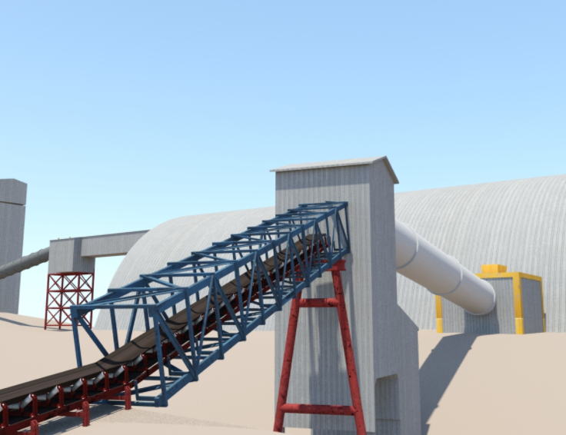
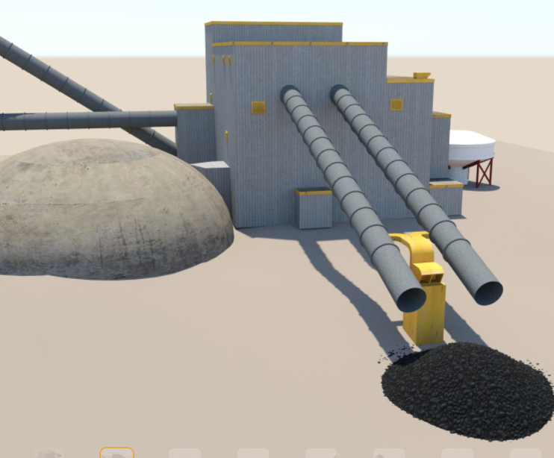
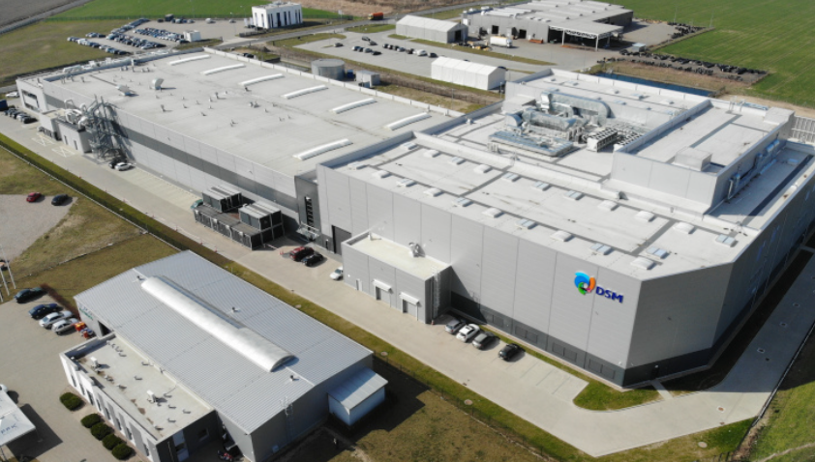
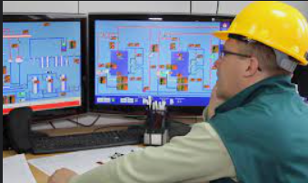
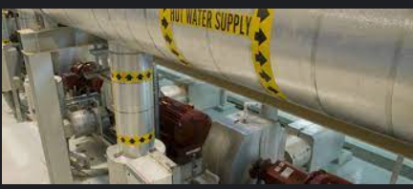
Site and Plant Layout
Process units
The process units and buildings need to be arranged in such a way that allows for the most economical flow of materials and people.
Dangerous processes need to be a safe distance from other buildings, and the layout should be planned to allow for future expansion.
Process units are usually laid out first in an arrangement that allows for smooth flow of materials between the process steps.
The distance between equipment is usually at least 30 m.
Location of the principal ancillary buildings are sited as to minimize the time that it takes the workers to travel between buildings.
Administrative offices and laboratories are located away from hazardous processes.
Control rooms are next to the processing equipment.
Utility buildings are located as to minimize piping between the process units.
Storage is placed between the loading and unloading facilities and next to the process units that they serve.
Tanks containing hazardous material are placed at least 70 m from the plant
ancillary buildings
Control room
Utility

Slide 11
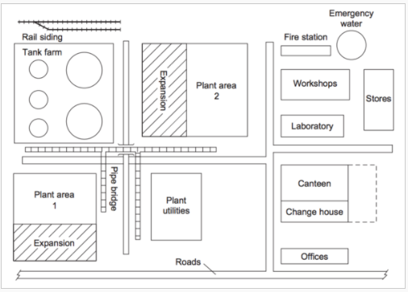
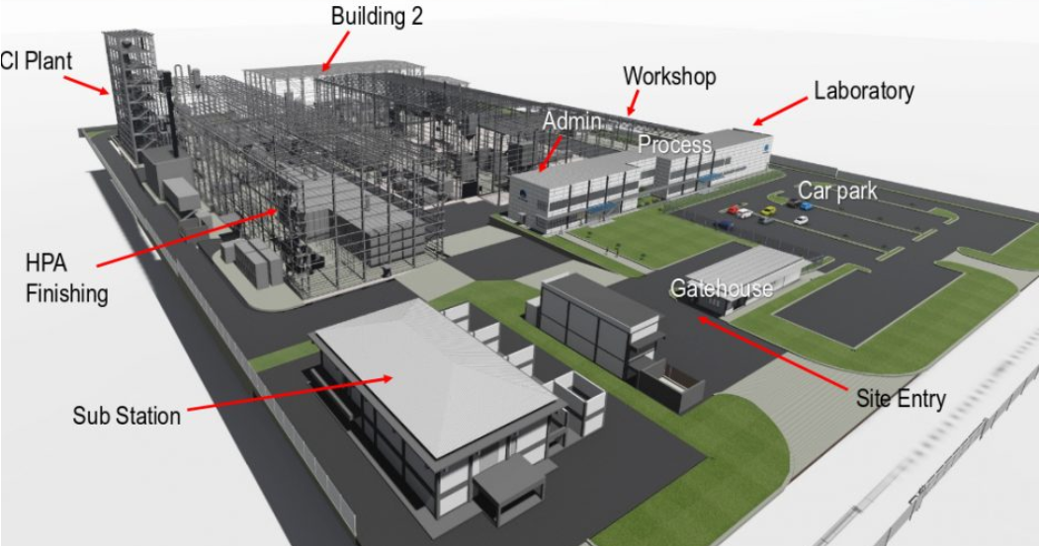
Typical layout

Slide 12
Plant Layout
Plant layout refers to the arrangement of physical facilities such as machinery, equipment, furniture. within the factory building in such a manner so as to have quickest flow of material at the lowest cost and with the least amount of handling in processing the product from the receipt of material to the shipment of the finished product

Slide 13
Meet quality and capacity requirement in the most economical manner
Minimize unit costs and optimize quality
Promote effective use of people, equipment, space and energy
Provide for employee safety and comfort
Control project costs
Achieve production deadlines

Slide 14
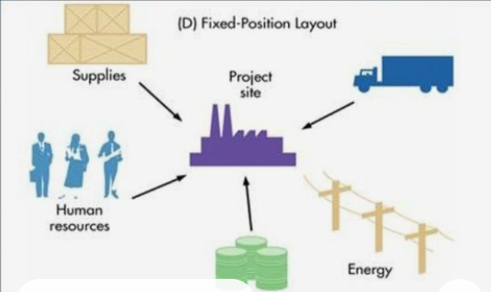
Type of plant layout
In fixed-position layouts, the item being worked on remains stationary, and workers, materials, and equipment are moved about as needed.

Slide 15
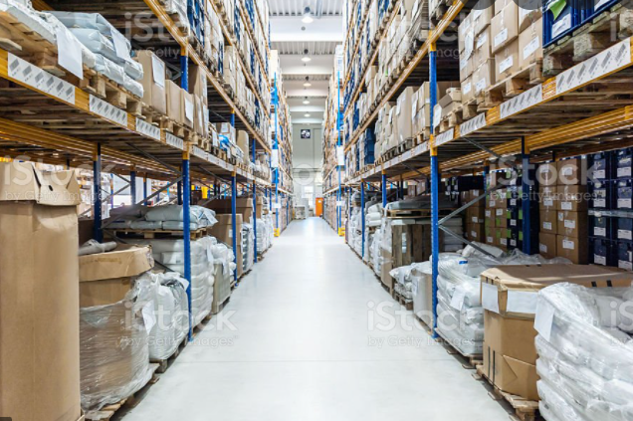
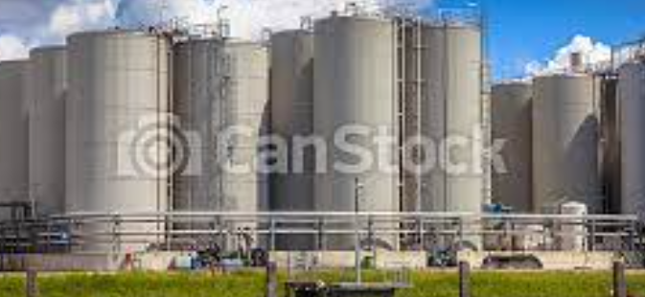
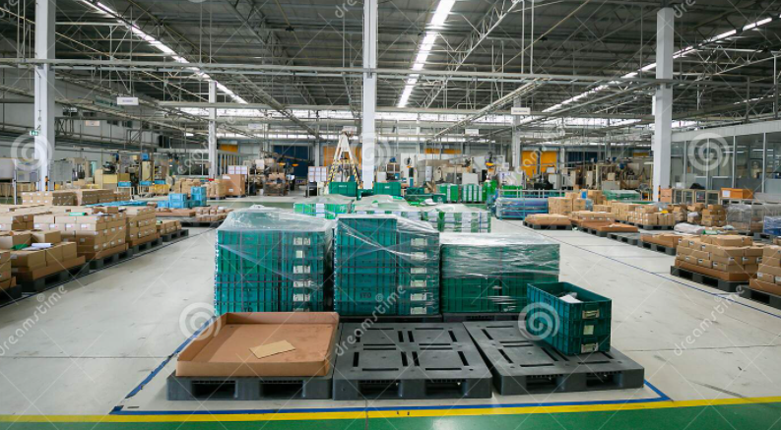
Storage areas

